Slide 1

William Stallings Computer Organization and Architecture 10th Edition
Notes:
Lecture slides prepared for “Computer Organization and Architecture”, 10/e, by William Stallings, Chapter 6 “External Memory”.

Slide 2
Performance Characteristics
Ts = Pc × Tc + (1-Pc) × (Tc +Tm) = Tc + (1-Pc) × Tm
Pc : Cache hit ratio
Tc : access time of cache
Tm : access time of main memory
Ex) Tc = 5ns, Tm=50ns, Pc=0.9 => Ts= 5 + 0.1 × 50 = 10ns
Cs = (Cc × Sc + Cm × Sm) / (Sc + Sm)
Cc : average cost per bit for cache
Sc : size of main memory
Notes:
When the on-chip cache first made an appearance,
many of the designs consisted of a single cache used to store references to both data
and instructions. More recently, it has become common to split the cache into two:
one dedicated to instructions and one dedicated to data. These two caches both exist
at the same level, typically as two L1 caches. When the processor attempts to fetch an
instruction from main memory, it first consults the instruction L1 cache, and when the
processor attempts to fetch data from main memory, it first consults the data L1 cache.
There are two potential advantages of a unified cache:
• For a given cache size, a unified cache has a higher hit rate than split caches
because it balances the load between instruction and data fetches automatically.
That is, if an execution pattern involves many more instruction fetches
than data fetches, then the cache will tend to fill up with instructions, and if an
execution pattern involves relatively more data fetches, the opposite will occur.
• Only one cache needs to be designed and implemented.
The trend is toward split caches at the L1 and unified caches for higher levels,
particularly for superscalar machines, which emphasize parallel instruction execution
and the prefetching of predicted future instructions. The key advantage of the
split cache design is that it eliminates contention for the cache between the instruction
fetch/decode unit and the execution unit. This is important in any design that
relies on the pipelining of instructions. Typically, the processor will fetch instructions
ahead of time and fill a buffer, or pipeline, with instructions to be executed. Suppose
now that we have a unified instruction/data cache. When the execution unit performs
a memory access to load and store data, the request is submitted to the unified cache.
If, at the same time, the instruction prefetcher issues a read request to the cache for
an instruction, that request will be temporarily blocked so that the cache can service
the execution unit first, enabling it to complete the currently executing instruction.
This cache contention can degrade performance by interfering with efficient use of
the instruction pipeline. The split cache structure overcomes this difficulty.

Slide 3
Table 5.1
Semiconductor Memory Types
Notes:
All of the memory types that we will explore in this chapter are random access. That is,
individual words of memory are directly accessed through wired-in addressing logic.
Table 5.1 lists the major types of semiconductor memory. The most common
is referred to as random-access memory (RAM). This is, in fact, a misuse of the
term, because all of the types listed in the table are random access. One distinguishing
characteristic of memory that is designated as RAM is that it is possible
both to read data from the memory and to write new data into the memory easily
and rapidly. Both the reading and writing are accomplished through the use of
electrical signals.
The other distinguishing characteristic of RAM is that it is volatile. A RAM
must be provided with a constant power supply. If the power is interrupted, then
the data are lost. Thus, RAM can be used only as temporary storage. The two traditional
forms of RAM used in computers are DRAM and SRAM.

Slide 4
Notes:
Figure 5.3 shows a typical organization of a 16-Mbit DRAM. In this case, 4 bits
are read or written at a time. Logically, the memory array is organized as four square
arrays of 2048 by 2048 elements. Various physical arrangements are possible. In any
case, the elements of the array are connected by both horizontal (row) and vertical
(column) lines. Each horizontal line connects to the Select terminal of each cell in its
row; each vertical line connects to the Data-In/Sense terminal of each cell in its column.
Address lines supply the address of the word to be selected. A total of log₂ W
lines are needed. In our example, 11 address lines are needed to select one of 2048
rows. These 11 lines are fed into a row decoder, which has 11 lines of input and 2048
lines for output. The logic of the decoder activates a single one of the 2048 outputs
depending on the bit pattern on the 11 input lines (2¹¹ = 2048).
An additional 11 address lines select one of 2048 columns of 4 bits per column.
Four data lines are used for the input and output of 4 bits to and from a data buffer.
On input (write), the bit driver of each bit line is activated for a 1 or 0 according to
the value of the corresponding data line. On output (read), the value of each bit line
is passed through a sense amplifier and presented to the data lines. The row line
selects which row of cells is used for reading or writing.
Because only 4 bits are read/written to this DRAM, there must be multiple
DRAMs connected to the memory controller to read/write a word of data to the bus.
Note that there are only 11 address lines (A0–A10), half the number you
would expect for a 2048 * 2048 array. This is done to save on the number of pins.
The 22 required address lines are passed through select logic external to the chip
and multiplexed onto the 11 address lines. First, 11 address signals are passed to the
chip to define the row address of the array, and then the other 11 address signals are
presented for the column address.
As an aside, multiplexed addressing plus the use of square arrays result in a
quadrupling of memory size with each new generation of memory chips. One more
pin devoted to addressing doubles the number of rows and columns, and so the size
of the chip memory grows by a factor of 4.
Figure 5.3 also indicates the inclusion of refresh circuitry. All DRAMs require
a refresh operation. A simple technique for refreshing is, in effect, to disable the
DRAM chip while all data cells are refreshed. The refresh counter steps through all
of the row values. For each row, the output lines from the refresh counter are supplied
to the row decoder and the RAS line is activated. The data are read out and
written back into the same location. This causes each cell in the row to be refreshed.

Slide 5
Interleaved Memory
Composed of a collection of DRAM chips
Grouped together to form a memory bank
Each bank is independently able to service a memory read or write request
K banks can service K requests simultaneously, increasing memory read or write rates by a factor of K
If consecutive words of memory are stored in different banks, the transfer of a block of memory is speeded up
Notes:
Main memory is composed of a collection of DRAM memory chips. A number of
chips can be grouped together to form a memory bank. It is possible to organize
the memory banks in a way known as interleaved memory. Each bank is independently
able to service a memory read or write request, so that a system with
K banks can service K requests simultaneously, increasing memory read or write
rates by a factor of K. If consecutive words of memory are stored in different
banks, then the transfer of a block of memory is speeded up. Appendix G explores
the topic of interleaved memory.

Slide 6
Chapter 6
External Memory
Notes:
This chapter examines a range of external memory devices and systems. We begin
with the most important device, the magnetic disk. Magnetic disks are the foundation
of external memory on virtually all computer systems. The next section examines
the use of disk arrays to achieve greater performance, looking specifically at
the family of systems known as RAID (Redundant Array of Independent Disks).
An increasingly important component of many computer systems is the solid state
disk, which is discussed next. Then, external optical memory is examined. Finally,
magnetic tape is described.

Slide 7
Notes:
A typical hierarchy is illustrated in
Figure 4.1. As one goes down the hierarchy, the following occur:
a. Decreasing cost per bit
b. Increasing capacity
c. Increasing access time
d. Decreasing frequency of access of the memory by the processor
Thus, smaller, more expensive, faster memories are supplemented by larger,
cheaper, slower memories. The key to the success of this organization is item (d)
:decreasing frequency of access. We examine this concept in greater detail when we
discuss the cache, later in this chapter, and virtual memory in Chapter 8. A brief
explanation is provided at this point.
The use of two levels of memory to reduce average access time works in principle,
but only if conditions (a) through (d) apply. By employing a variety of technologies,
a spectrum of memory systems exists that satisfies conditions (a) through
(c). Fortunately, condition (d) is also generally valid.
The basis for the validity of condition (d) is a principle known as locality of
reference [DENN68]. During the course of execution of a program, memory references
by the processor, for both instructions and data, tend to cluster. Programs
typically contain a number of iterative loops and subroutines. Once a loop or subroutine
is entered, there are repeated references to a small set of instructions.
Similarly, operations on tables and arrays involve access to a clustered set of data
words. Over a long period of time, the clusters in use change, but over a short period
of time, the processor is primarily working with fixed clusters of memory references.

Slide 8
Notes:
The head is a relatively small device capable of reading from or writing to a portion
of the platter rotating beneath it. This gives rise to the organization of data on the
platter in a concentric set of rings, called tracks . Each track is the same width as the
head. There are thousands of tracks per surface.
Figure 6.2 depicts this data layout. Adjacent tracks are separated by intertrack
gaps . This prevents, or at least minimizes, errors due to misalignment of the head
or simply interference of magnetic fields. Data are transferred to and from the disk
in sectors . There are typically hundreds of sectors per track, and these may be of
either fixed or variable length. In most contemporary systems, fixed-
length sectors are used, with 512 bytes being the nearly universal sector size. To avoid imposing
unreasonable precision requirements on the system, adjacent sectors are separated
by intersector gaps.

Slide 9
Notes:
Some means is needed to locate sector positions within a track. Clearly, there
must be some starting point on the track and a way of identifying the start and end
of each sector. These requirements are handled by means of control data recorded
on the disk. Thus, the disk is formatted with some extra data used only by the disk
drive and not accessible to the user.
An example of disk formatting is shown in Figure 6.4. In this case, each track
contains 30 fixed-length sectors of 600 bytes each. Each sector holds 512 bytes of
data plus control information useful to the disk controller. The ID field is a unique
identifier or address used to locate a particular sector. The SYNCH byte is a special
bit pattern that delimits the beginning of the field. The track number identifies a
track on a surface. The head number identifies a head, because this disk has multiple
surfaces (explained presently). The ID and data fields each contain an error detecting
code.

Slide 10
Characteristics
Fixed-head disk
One read-write head per track
Heads are mounted on a fixed ridged arm that extends across all tracks
Movable-head disk
One read-write head
Head is mounted on an arm
The arm can be extended or retracted
Removable disk
Can be removed and replaced with another disk
Advantages:
Unlimited amounts of data are available with a limited number of disk systems
A disk may be moved from one computer system to another
Floppy disks and ZIP cartridge disks are examples of removable disks
Non-removable disk
Permanently mounted in the disk drive
The hard disk in a personal computer is a non-removable disk
Double sided disk
Magnetizable coating is applied to both sides of the platter
Notes:
First, the head may either be fixed or movable with respect to
the radial direction of the platter. In a fixed-head disk, there is one read-write
head per track. All of the heads are mounted on a rigid arm that extends across
all tracks; such systems are rare today. In a movable-head disk, there is only one
read-write head. Again, the head is mounted on an arm. Because the head must
be able to be positioned above any track, the arm can be extended or retracted for
this purpose.
The disk itself is mounted in a disk drive, which consists of the arm, a spindle
that rotates the disk, and the electronics needed for input and output of binary data.
A non-removable disk is permanently mounted in the disk drive; the hard disk in
a personal computer is a non-removable disk. A removable disk can be removed
and replaced with another disk. The advantage of the latter type is that unlimited
amounts of data are available with a limited number of disk systems. Furthermore,
such a disk may be moved from one computer system to another. Floppy disks and
ZIP cartridge disks are examples of removable disks.
For most disks, the magnetizable coating is applied to both sides of the platter,
which is then referred to as double sided. Some less expensive disk systems use
single-sided disks.
Some disk drives accommodate multiple platters stacked vertically a fraction
of an inch apart. Multiple arms are provided (Figure 6.2). Multiple–
platter disks employ a movable head, with one read-write
head per platter surface. All of the
heads are mechanically fixed so that all are at the same distance from the center of
the disk and move together. Thus, at any time, all of the heads are positioned over
tracks that are of equal distance from the center of the disk. The set of all the tracks
in the same relative position on the platter is referred to as a cylinder . This is illustrated
in Figure 6.2.

Slide 11
Disk Classification
The head mechanism provides a classification of disks into three types
The head must generate or sense an electromagnetic field of sufficient magnitude to write and read properly
The narrower the head, the closer it must be to the platter surface to function
A narrower head means narrower tracks and therefore greater data density
The closer the head is to the disk the greater the risk of error from impurities or imperfections
Winchester Heads
Used in sealed drive assemblies that are almost free of contaminants
Designed to operate closer to the disk’s surface than conventional rigid disk heads, thus allowing greater data density
Is actually an aerodynamic foil that rests lightly on the platter’s surface when the disk is motionless
The air pressure generated by a spinning disk is enough to make the foil rise above the surface
Notes:
Finally, the head mechanism provides a classification of disks into three types.
Traditionally, the read-write head has been positioned a fixed distance above the
platter, allowing an air gap. At the other extreme is a head mechanism that actually
comes into physical contact with the medium during a read or write operation. This
mechanism is used with the floppy disk, which is a small, flexible platter and the
least expensive type of disk.
To understand the third type of disk, we need to comment on the relationship
between data density and the size of the air gap. The head must generate or sense an
electromagnetic field of sufficient magnitude to write and read properly. The narrower
the head is, the closer it must be to the platter surface to function. A narrower
head means narrower tracks and therefore greater data density, which is desirable.
However, the closer the head is to the disk, the greater the risk of error from impurities
or imperfections. To push the technology further, the Winchester disk was
developed. Winchester heads are used in sealed drive assemblies that are almost
free of contaminants. They are designed to operate closer to the disk’s surface than
conventional rigid disk heads, thus allowing greater data density. The head is actually
an aerodynamic foil that rests lightly on the platter’s surface when the disk is
motionless. The air pressure generated by a spinning disk is enough to make the foil
rise above the surface. The resulting noncontact system can be engineered to use
narrower heads that operate closer to the platter’s surface than conventional rigid
disk heads.

Slide 12
Notes:
The actual details of disk I/O operation depend on the computer system, the operating
system, and the nature of the I/O channel and disk controller hardware. A
general timing diagram of disk I/O transfer is shown in Figure 6.5.

Slide 13

Disk Performance Parameters
When the disk drive is operating the disk is rotating at constant speed
To read or write the head must be positioned at the desired track and at the beginning of the desired sector on the track
Track selection involves moving the head in a movable-head system or electronically selecting one head on a fixed-head system
Once the track is selected, the disk controller waits until the appropriate sector rotates to line up with the head
Seek time
On a movable–head system, the time it takes to position the head at the track
Rotational delay (rotational latency)
The time it takes for the beginning of the sector to reach the head
Access time
The sum of the seek time and the rotational delay
The time it takes to get into position to read or write
Transfer time
Once the head is in position, the read or write operation is then performed as the sector moves under the head
This is the data transfer portion of the operation
Notes:
When the disk drive is operating, the disk is rotating at constant speed. To
read or write, the head must be positioned at the desired track and at the beginning
of the desired sector on that track. Track selection involves moving the head in a
movable-head system or electronically selecting one head on a fixed-head system.
On a movable-head system, the time it takes to position the head at the track is
known as seek time. In either case, once the track is selected, the disk controller
waits until the appropriate sector rotates to line up with the head. The time it takes
for the beginning of the sector to reach the head is known as rotational delay, or
rotational latency. The sum of the seek time, if any, and the rotational delay equals
the access time, which is the time it takes to get into position to read or write. Once
the head is in position, the read or write operation is then performed as the sector
moves under the head; this is the data transfer portion of the operation; the time
required for the transfer is the transfer time.
In addition to the access time and transfer time, there are several queuing
delays normally associated with a disk I/O operation. When a process issues an I/O
request, it must first wait in a queue for the device to be available. At that time, the
device is assigned to the process. If the device shares a single I/O channel or a set
of I/O channels with other disk drives, then there may be an additional wait for the
channel to be available. At that point, the seek is performed to begin disk access.
In some high-end systems for servers, a technique known as rotational positional
sensing (RPS) is used. This works as follows: When the seek command has
been issued, the channel is released to handle other I/O operations. When the seek
is completed, the device determines when the data will rotate under the head. As
that sector approaches the head, the device tries to reestablish the communication
path back to the host. If either the control unit or the channel is busy with another
I/O, then the reconnection attempt fails and the device must rotate one whole
revolution before it can attempt to reconnect, which is called an RPS miss. This is
an extra delay element that must be added to the timeline of Figure 6.5.
It is clear that the order in which sectors are read from the disk has a tremendous
effect on I/O performance. In the case of file access in which multiple
sectors are read or written, we have some control over the way in which sectors
of data are deployed. However, even in the case of a file access, in a multiprogramming
environment, there will be I/O requests competing for the same disk.
Thus, it is worthwhile to examine ways in which the performance of disk I/O
can be improved over that achieved with purely random access to the disk. This
leads to a consideration of disk scheduling algorithms, which is the province of
the operating system and beyond the scope of this book (see [STAL15] for a
discussion).

Slide 14
RAID
Consists of 7 levels
Levels do not imply a hierarchical relationship but designate different design architectures that share three common characteristics:
Set of physical disk drives viewed by the operating system as a single logical drive
Data are distributed across the physical drives of an array in a scheme known as striping
Redundant disk capacity is used to store parity information, which guarantees data recoverability in case of a disk failure
Redundant Array of Independent Disks
Notes:
With the use of multiple disks, there is a wide variety of ways in which the
data can be organized and in which redundancy can be added to improve reliability.
This could make it difficult to develop database schemes that are usable
on a number of platforms and operating systems. Fortunately, industry has
agreed on a standardized scheme for multiple-disk database design, known as
RAID (Redundant Array of Independent Disks). The RAID scheme consists
of seven levels, zero through six. These levels do not imply a hierarchical relationship
but designate different design architectures that share three common
characteristics:
1. RAID is a set of physical disk drives viewed by the operating system as a single
logical drive.
2. Data are distributed across the physical drives of an array in a scheme known
as striping, described subsequently.
3. Redundant disk capacity is used to store parity information, which guarantees
data recoverability in case of a disk failure.
The details of the second and third characteristics differ for the different RAID
levels. RAID 0 and RAID 1 do not support the third characteristic.
The term RAID was originally coined in a paper by a group of researchers
at the University of California at Berkeley [PATT88]. The paper outlined various
RAID configurations and applications and introduced the definitions of the
RAID levels that are still used. The RAID strategy employs multiple disk drives
and distributes data in such a way as to enable simultaneous access to data from
multiple drives, thereby improving I/O performance and allowing easier incremental
increases in capacity.

Slide 15
Notes:
Figure 6.6 illustrates the use of the seven RAID schemes to support a data
capacity requiring four disks with no redundancy. The figures highlight the layout
of user data and redundant data and indicates the relative storage requirements of
the various levels. We refer to these figures throughout the following discussion.
Of the seven RAID levels described, only four are commonly used: RAID levels
0, 1, 5, and 6.

Slide 16
Notes:
Figure 6.6 continued.

Slide 17
Notes:
RAID level 0 is not a true member of the RAID family because it does not include
redundancy to improve performance. However, there are a few applications, such as
some on supercomputers in which performance and capacity are primary concerns
and low cost is more important than improved reliability.
For RAID 0, the user and system data are distributed across all of the disks in
the array. This has a notable advantage over the use of a single large disk: If two-
different I/O requests are pending for two different blocks of data, then there is a
good chance that the requested blocks are on different disks. Thus, the two requests
can be issued in parallel, reducing the I/O queuing time.
But RAID 0, as with all of the RAID levels, goes further than simply distributing
the data across a disk array: The data are striped across the available disks. This
is best understood by considering Figure 6.7. All of the user and system data are
viewed as being stored on a logical disk. The logical disk is divided into strips; these
strips may be physical blocks, sectors, or some other unit. The strips are mapped
round robin to consecutive physical disks in the RAID array. A set of logically consecutive
strips that maps exactly one strip to each array member is referred to as a
stripe. In an n-disk array, the first n logical strips are physically stored as the first
strip on each of the n disks, forming the first stripe; the second n strips are distributed
as the second strips on each disk; and so on. The advantage of this layout is that if a
single I/O request consists of multiple logically contiguous strips, then up to n strips
for that request can be handled in parallel, greatly reducing the I/O transfer time.
Figure 6.7 indicates the use of array management software to map between
logical and physical disk space. This software may execute either in the disk subsystem
or in a host computer.

Slide 18
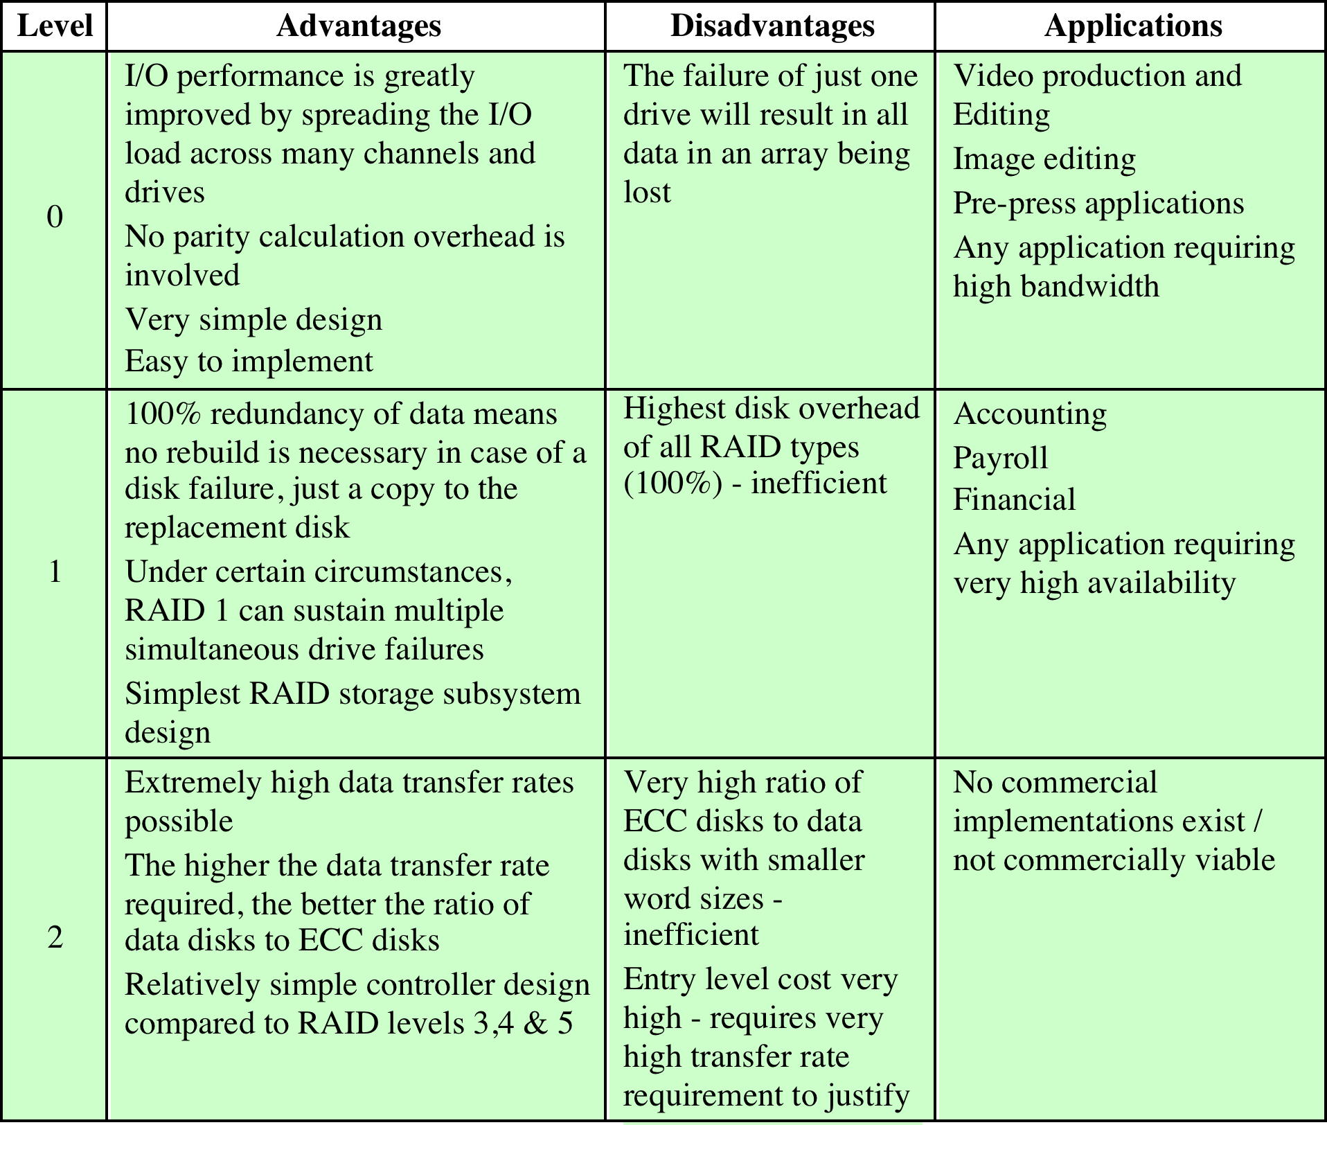
Table 6.4
RAID Comparison (page 1 of 2)
Notes:
Table 6.4 is a comparative summary of the seven levels.

Slide 19
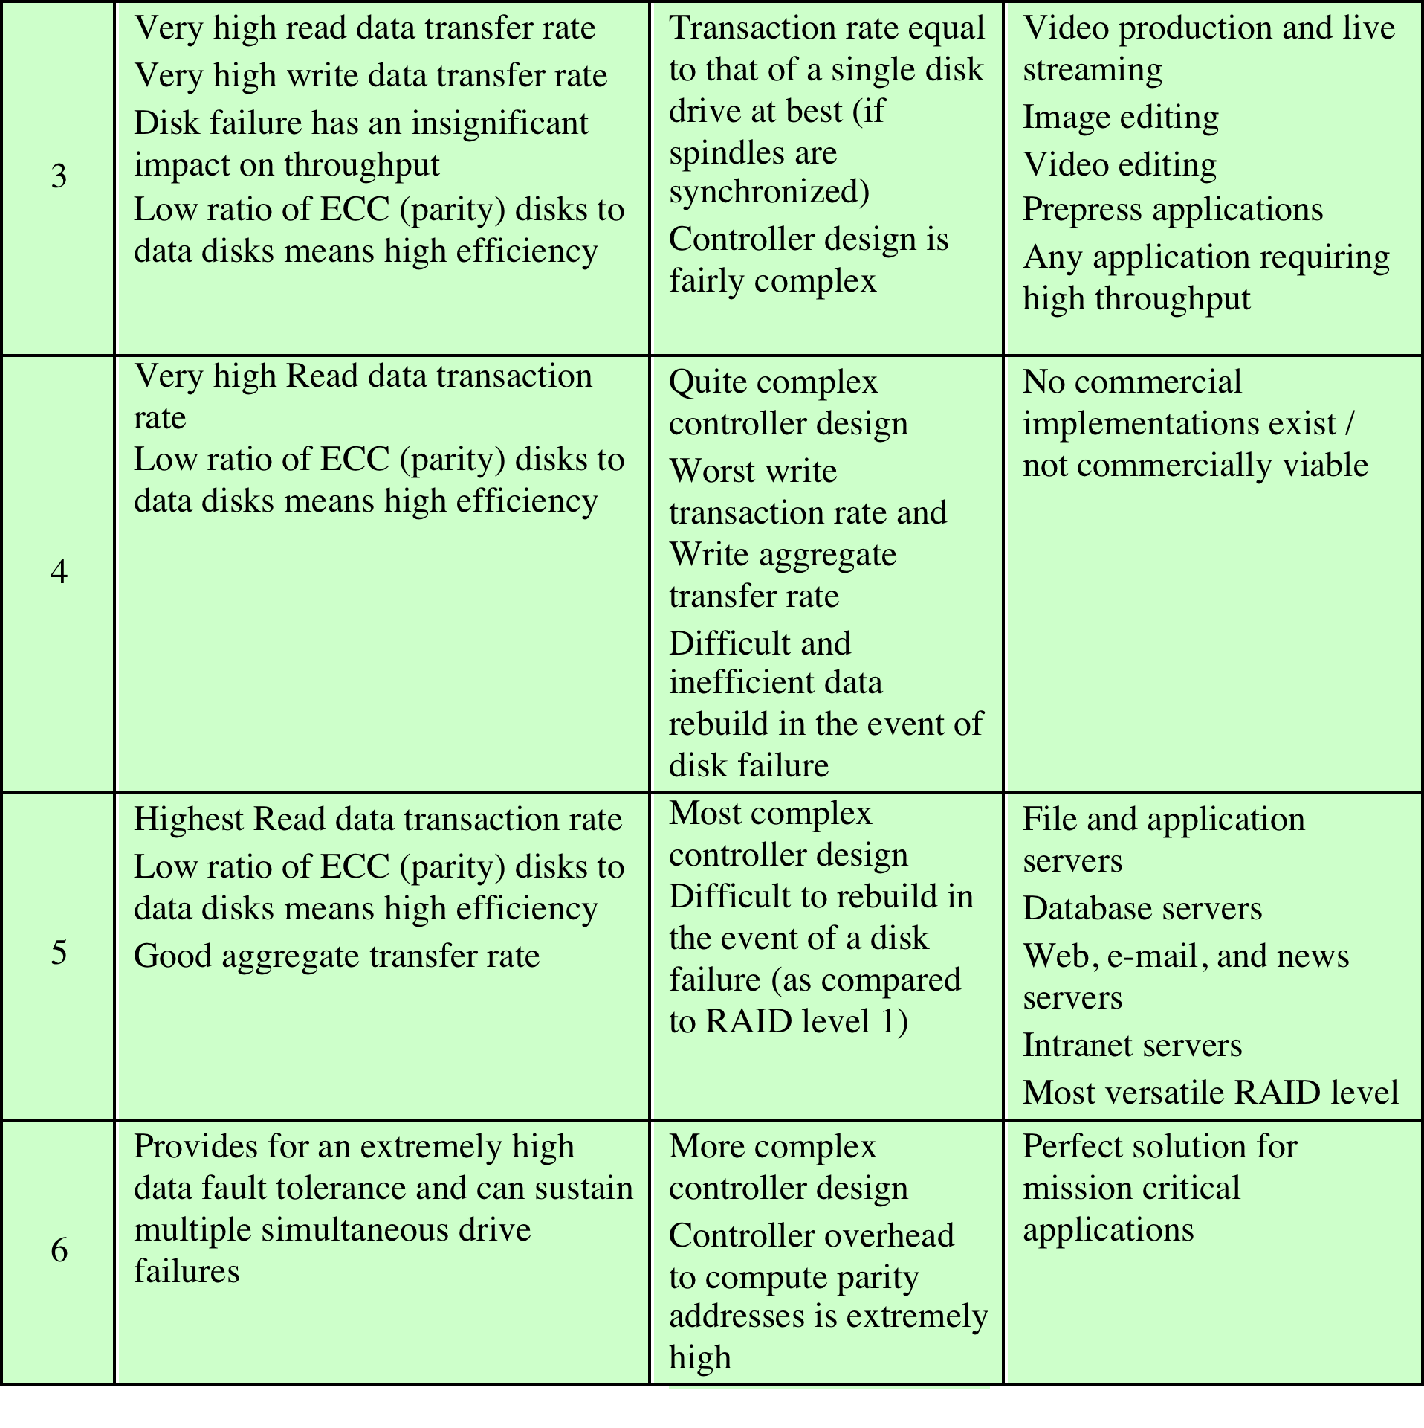
Table 6.4
RAID Comparison (page 2 of 2)
Notes:
Table 6.4 RAID comparison (page 2 of 2)

Slide 20
SSD Compared to HDD
SSDs have the following advantages over HDDs:
High-performance input/output operations per second (IOPS)
Durability
Longer lifespan
Lower power consumption
Quieter and cooler running capabilities
Lower access times and latency rates
Notes:
SSDs have the following advantages over HDDs:
• High-performance input/output operations per second (IOPS): Significantly
increases performance I/O subsystems.
• Durability: Less susceptible to physical shock and vibration.
• Longer lifespan: SSDs are not susceptible to mechanical wear.
• Lower power consumption: SSDs use considerably less than comparable-size HDDs.
• Quieter and cooler running capabilities: Less floor space required, lower
energy costs, and a greener enterprise.
• Lower access times and latency rates: Over 10 times faster than the spinning
disks in an HDD.
Currently, HDDs enjoy a cost per bit advantage and a capacity advantage, but
these differences are shrinking.

Slide 21
Table 6.5
Comparison of Solid State Drives and Disk Drives
Notes:
As the cost of flash-based SSDs has dropped and the performance and bit density
increased, SSDs have become increasingly competitive with HDDs. Table 6.5 shows
typical measures of comparison at the time of this writing.

Slide 22
Notes:
Figure 6.8 illustrates a general view of the common architectural system component
associated with any SSD system. On the host system, to operating system invokes
file system software to access data on the disk. The file system, in turn, invokes I/O
driver software. The I/O driver software provides host access to the particular SSD
product. The interface component in Figure 6.8 refers to the physical and electrical
interface between the host processor and the SSD peripheral device. If the device is
an internal hard drive, a common interface is PCIe. For external devices, one common
interface is USB.
In addition to the interface to the host system, the SSD contains the following
components:
• Controller: Provides SSD device level interfacing and firmware execution.
• Addressing: Logic that performs the selection function across the flash
memory components.
• Data buffer/cache: High speed RAM memory components used for speed
matching and to increased data throughput.
• Error correction: Logic for error detection and correction.
• Flash memory components: Individual NAND flash chips.

Slide 23
Practical Issues
There are two practical issues peculiar to SSDs that are not faced by HDDs:
Flash memory becomes unusable after a certain number of writes
Techniques for prolonging life:
Front-ending the flash with a cache to delay and group write operations
Using wear-leveling algorithms that evenly distribute writes across block of cells
Bad-block management techniques
Most flash devices estimate their own remaining lifetimes so systems can anticipate failure and take preemptive action
SDD performance has a tendency to slow down as the device is used
The entire block must be read from the flash memory and placed in a RAM buffer
Before the block can be written back to flash memory, the entire block of flash memory must be erased
The entire block from the buffer is now written back to the flash memory
Notes:
There are two practical issues peculiar to SSDs that are not faced by HDDs. First,
SDD performance has a tendency to slow down as the device is used. To understand
the reason for this, you need to know that files are stored on disk as a set of pages,
typically 4 KB in length. These pages are not necessarily, and indeed not typically,
stored as a contiguous set of pages on the disk. The reason for this arrangement is
explained in our discussion of virtual memory in Chapter 8. However, flash memory
is accessed in blocks, with a typically block size of 512 KB, so that there are typically
128 pages per block. Now consider what must be done to write a page onto a flash
memory.
1. The entire block must be read from the flash memory and placed in a RAM
buffer. Then the appropriate page in the RAM buffer is updated.
2. Before the block can be written back to flash memory, the entire block of flash
memory must be erased—it is not possible to erase just one page of the flash
memory.
3. The entire block from the buffer is now written back to the flash memory.
Now, when a flash drive is relatively empty and a new file is created, the
pages of that file are written on to the drive contiguously, so that one or only a few
blocks are affected. However, over time, because of the way virtual memory works,
files become fragmented, with pages scattered over multiple blocks. As the drive
become more occupied, there is more fragmentation, so the writing of a new file can
affect multiple blocks. Thus, the writing of multiple pages from one block becomes
slower, the more fully occupied the disk is. Manufacturers have developed a variety
of techniques to compensate for this property of flash memory, such as setting aside
a substantial portion of the SSD as extra space for write operations (called over provisioning),
then to erase inactive pages during idle time used to defragment the
disk. Another technique is the TRIM command, which allows an operating system
to inform a solid state drive (SSD) which blocks of data are no longer considered in
use and can be wiped internally.
A second practical issue with flash memory drives is that a flash memory
becomes unusable after a certain number of writes. As flash cells are stressed,
they lose their ability to record and retain values. A typical limit is 100,000 writes
[GSOE08]. Techniques for prolonging the life of an SSD drive include front-ending
the flash with a cache to delay and group write operations, using wear-leveling algorithms
that evenly distribute writes across block of cells, and sophisticated bad-block
management techniques. In addition, vendors are deploying SSDs in RAID configurations
to further reduce the probability of data loss. Most flash devices are also
capable of estimating their own remaining lifetimes so systems can anticipate failure
and take preemptive action.

Slide 24
Table 6. 6
Optical
Disk
Products
Notes:
In 1983, one of the most successful consumer products of all time was introduced:
the compact disk (CD) digital audio system. The CD is a non-erasable disk that can
store more than 60 minutes of audio information on one side. The huge commercial
success of the CD enabled the development of low-cost optical-disk storage
technology that has revolutionized computer data storage. A variety of optical-disk
systems have been introduced (Table 6.6). We briefly review each of these.

Slide 25
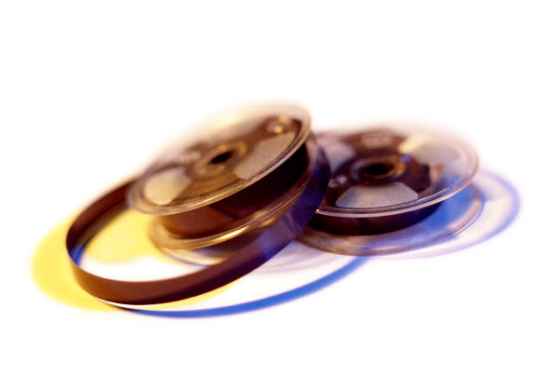
Magnetic Tape
Tape systems use the same reading and recording techniques as disk systems
Medium is flexible polyester tape coated with magnetizable material
Coating may consist of particles of pure metal in special binders or vapor-plated metal films
Data on the tape are structured as a number of parallel tracks running lengthwise
Serial recording
Data are laid out as a sequence of bits along each track
Data are read and written in contiguous blocks called physical records
Blocks on the tape are separated by gaps referred to as inter-record gaps
Notes:
Tape systems use the same reading and recording techniques as disk systems. The
medium is flexible polyester (similar to that used in some clothing) tape coated with
magnetizable material. The coating may consist of particles of pure metal in special
binders or vapor-plated metal films. The tape and the tape drive are analogous
to a home tape recorder system. Tape widths vary from 0.38 cm (0.15 inch) to
1.27 cm (0.5 inch). Tapes used to be packaged as open reels that have to be threaded
through a second spindle for use. Today, virtually all tapes are housed in cartridges.
Data on the tape are structured as a number of parallel tracks running lengthwise.
Earlier tape systems typically used nine tracks. This made it possible to store
data one byte at a time, with an additional parity bit as the ninth track. This was
followed by tape systems using 18 or 36 tracks, corresponding to a digital word or
double word. The recording of data in this form is referred to as parallel recording.
Most modern systems instead use serial recording, in which data are laid out as a
sequence of bits along each track, as is done with magnetic disks. As with the disk,
data are read and written in contiguous blocks, called physical records, on a tape.
Blocks on the tape are separated by gaps referred to as inter-record gaps. As with the
disk, the tape is formatted to assist in locating physical records.

Slide 26
Summary
External Memory
Chapter 6
RAID
RAID level 0
RAID level 1
RAID level 2
RAID level 3
RAID level 4
RAID level 5
RAID level 6
Optical memory
Compact disk
Digital versatile disk
High-definition optical disks
Magnetic disk
Magnetic read and write mechanisms
Data organization and formatting
Physical characteristics
Disk performance parameters
Solid state drives
SSD compared to HDD
SSD organization
Practical issues
Magnetic tape
Notes:
Chapter 6 summary.

Slide 27
Chapter 7
Input/Output
Notes:
In addition to the processor and a set of memory modules, the third key element
of a computer system is a set of I/O modules. Each module interfaces to the system
bus or central switch and controls one or more peripheral devices. An I/O module
is not simply a set of mechanical connectors that wire a device into the system bus.
Rather, the I/O module contains logic for performing a communication function
between the peripheral and the bus.
The reader may wonder why one does not connect peripherals directly to the
system bus. The reasons are as follows:
• There are a wide variety of peripherals with various methods of operation. It
would be impractical to incorporate the necessary logic within the processor
to control a range of devices.
• The data transfer rate of peripherals is often much slower than that of the
memory or processor. Thus, it is impractical to use the high-speed system bus
to communicate directly with a peripheral.
• On the other hand, the data transfer rate of some peripherals is faster than
that of the memory or processor. Again, the mismatch would lead to inefficiencies
if not managed properly.
• Peripherals often use different data formats and word lengths than the
computer to which they are attached.

Slide 28
Notes:
Thus, an I/O module is required. This module has two major functions
(Figure 7.1):
• Interface to the processor and memory via the system bus or central switch
• Interface to one or more peripheral devices by tailored data links
We begin this chapter with a brief discussion of external devices, followed by
an overview of the structure and function of an I/O module. Then we look at the
various ways in which the I/O function can be performed in cooperation with the
processor and memory: the internal I/O interface. Finally, we examine the external
I/O interface, between the I/O module and the outside world.

Slide 29
External Devices
Three categories:
Human readable
Suitable for communicating with the computer user
Video display terminals (VDTs), printers
Machine readable
Suitable for communicating with equipment
Magnetic disk and tape systems, sensors and actuators
Communication
Suitable for communicating with remote devices such as a terminal, a machine readable device, or another computer
Provide a means of exchanging data between the external environment and the computer
Attach to the computer by a link to an I/O module
The link is used to exchange control, status, and data between the I/O module and the external device
Peripheral device
An external device connected to an I/O module
Notes:
I/O operations are accomplished through a wide assortment of external devices
that provide a means of exchanging data between the external environment
and the computer. An external device attaches to the computer by a link to
an I/O module (Figure 7.1). The link is used to exchange control, status, and
data between the I/O module and the external device. An external device connected
to an I/O module is often referred to as a peripheral device or, simply, a
peripheral.
We can broadly classify external devices into three categories:
• Human readable: Suitable for communicating with the computer user
• Machine readable: Suitable for communicating with equipment
• Communication: Suitable for communicating with remote devices
Examples of human-readable devices are video display terminals (VDTs) and
printers. Examples of machine-readable devices are magnetic disk and tape systems,
and sensors and actuators, such as are used in a robotics application. Note
that we are viewing disk and tape systems as I/O devices in this chapter, whereas
in Chapter 6 we viewed them as memory devices. From a functional point of view,
these devices are part of the memory hierarchy, and their use is appropriately discussed
in Chapter 6. From a structural point of view, these devices are controlled by
I/O modules and are hence to be considered in this chapter.
Communication devices allow a computer to exchange data with a remote
device, which may be a human-readable device, such as a terminal, a machine readable
device, or even another computer.

Slide 30
Notes:
In very general terms, the nature of an external device is indicated in
Figure 7.2. The interface to the I/O module is in the form of control, data, and status
signals. Control signals determine the function that the device will perform, such as
send data to the I/O module (INPUT or READ), accept data from the I/O module
(OUTPUT or WRITE), report status, or perform some control function particular
to the device (e.g., position a disk head). Data are in the form of a set of bits to
be sent to or received from the I/O module. Status signals indicate the state of the
device. Examples are READY/NOT-READY to show whether the device is ready
for data transfer.
Control logic associated with the device controls the device’s operation in
response to direction from the I/O module. The transducer converts data from electrical
to other forms of energy during output and from other forms to electrical
during input. Typically, a buffer is associated with the transducer to temporarily
hold data being transferred between the I/O module and the external environment.
A buffer size of 8 to 16 bits is common for serial devices, whereas block-
oriented devices such as disk drive controllers may have much larger buffers.
The interface between the I/O module and the external device will be examined
in Section 7.7. The interface between the external device and the environment
is beyond the scope of this book, but several brief examples are given here.
A disk drive contains electronics for exchanging data, control, and status signals with
an I/O module plus the electronics for controlling the disk read/write mechanism.
In a fixed-head disk, the transducer is capable of converting between the magnetic
patterns on the moving disk surface and bits in the device’s buffer (Figure 7.2). A
Moving-head disk must also be able to cause the disk arm to move radially in and
out across the disk’s surface.

Slide 31
Keyboard/Monitor
Most common means of computer/user interaction
User provides input through the keyboard
The monitor displays data provided by the computer
International Reference Alphabet (IRA)
Basic unit of exchange is the character
Associated with each character is a code
Each character in this code is represented by a unique 7-bit binary code
128 different characters can be represented
Characters are of two types:
Printable
Alphabetic, numeric, and special characters that can be printed on paper or displayed on a screen
Control
Have to do with controlling the printing or displaying of characters
Example is carriage return
Other control characters are concerned with communications procedures
Keyboard Codes
When the user depresses a key it generates an electronic signal that is interpreted by the transducer in the keyboard and translated into the bit pattern of the corresponding IRA code
This bit pattern is transmitted to the I/O module in the computer
On output, IRA code characters are transmitted to an external device from the I/O module
The transducer interprets the code and sends the required electronic signals to the output device either to display the indicated character or perform the requested control function
Notes:
The most common means of computer/user interaction is a keyboard/monitor
arrangement. The user provides input through the keyboard. This input is then
transmitted to the computer and may also be displayed on the monitor. In addition,
the monitor displays data provided by the computer.
The basic unit of exchange is the character. Associated with each character
is a code, typically 7 or 8 bits in length. The most commonly used text code is the
International Reference Alphabet (IRA). Each character in this code is represented
by a unique 7-bit binary code; thus, 128 different characters can be represented.
Characters are of two types: printable and control. Printable characters are
the alphabetic, numeric, and special characters that can be printed on paper or displayed
on a screen. Some of the control characters have to do with controlling the
printing or displaying of characters; an example is carriage return. Other control
characters are concerned with communications procedures. See Appendix H for
details.
For keyboard input, when the user depresses a key, this generates an
electronic signal that is interpreted by the transducer in the keyboard and
translated into the bit pattern of the corresponding IRA code. This bit pattern
is then transmitted to the I/O module in the computer. At the computer, the
text can be stored in the same IRA code. On output, IRA code characters are
transmitted to an external device from the I/O module. The transducer at the
device interprets this code and sends the required electronic signals to the output
device either to display the indicated character or perform the requested
control function.

Slide 32
The major functions for an I/O module fall into the following categories:
Control and timing
Coordinates the flow of traffic between internal resources and external devices
Processor communication
Involves command decoding, data, status reporting, address recognition
Device communication
Involves commands, status information, and data
Data buffering
Performs the needed buffering operation to balance device and memory speeds
Error detection
Detects and reports transmission errors
Notes:
The major functions or requirements for an I/O module fall into the following
categories:
• Control and timing
• Processor communication
• Device communication
• Data buffering
• Error detection
During any period of time, the processor may communicate with one or more
external devices in unpredictable patterns, depending on the program’s need for I/O.
The internal resources, such as main memory and the system bus, must be shared
among a number of activities, including data I/O. Thus, the I/O function includes a
control and timing requirement, to coordinate the flow of traffic between internal
resources and external devices. For example, the control of the transfer of data from
an external device to the processor might involve the following sequence of steps:
1. The processor interrogates the I/O module to check the status of the attached
device.
2. The I/O module returns the device status.
3. If the device is operational and ready to transmit, the processor requests the
transfer of data, by means of a command to the I/O module.
4. The I/O module obtains a unit of data (e.g., 8 or 16 bits) from the external device.
5. The data are transferred from the I/O module to the processor.
If the system employs a bus, then each of the interactions between the processor
and the I/O module involves one or more bus arbitrations.
The preceding simplified scenario also illustrates that the I/O module must
communicate with the processor and with the external device. Processor communication
involves the following:
• Command decoding: The I/O module accepts commands from the processor,
typically sent as signals on the control bus. For example, an I/O module for a
disk drive might accept the following commands: READ SECTOR, WRITE
SECTOR, SEEK track number, and SCAN record ID. The latter two commands
each include a parameter that is sent on the data bus.
• Data: Data are exchanged between the processor and the I/O module over the
data bus.
• Status reporting: Because peripherals are so slow, it is important to know the
status of the I/O module. For example, if an I/O module is asked to send data
to the processor (read), it may not be ready to do so because it is still working
on the previous I/O command. This fact can be reported with a status signal.
Common status signals are BUSY and READY. There may also be signals to
report various error conditions.
• Address recognition: Just as each word of memory has an address, so does
each I/O device. Thus, an I/O module must recognize one unique address for
each peripheral it controls.
On the other side, the I/O module must be able to perform device communication.
This communication involves commands, status information, and data
(Figure 7.2).
An essential task of an I/O module is data buffering. The need for this function
is apparent from Figure 2.1. Whereas the transfer rate into and out of main
memory or the processor is quite high, the rate is orders of magnitude lower for
many peripheral devices and covers a wide range. Data coming from main memory
are sent to an I/O module in a rapid burst. The data are buffered in the I/O module
and then sent to the peripheral device at its data rate. In the opposite direction, data
are buffered so as not to tie up the memory in a slow transfer operation. Thus, the
I/O module must be able to operate at both device and memory speeds. Similarly, if
the I/O device operates at a rate higher than the memory access rate, then the I/O
module performs the needed buffering operation.
Finally, an I/O module is often responsible for error detection and for subsequently
reporting errors to the processor. One class of errors includes mechanical
and electrical malfunctions reported by the device (e.g., paper jam, bad disk track).
Another class consists of unintentional changes to the bit pattern as it is transmitted
from device to I/O module. Some form of error-detecting code is often used
to detect transmission errors. A simple example is the use of a parity bit on each
character of data. For example, the IRA character code occupies 7 bits of a byte.
The eighth bit is set so that the total number of 1s in the byte is even (even parity)
or odd (odd parity). When a byte is received, the I/O module checks the parity to
determine whether an error has occurred.

Slide 33
Notes:
I/O modules vary considerably in complexity and the number of external devices
that they control. We will attempt only a very general description here. (One specific
device, the Intel 82C55A, is described in Section 7.4.) Figure 7.3 provides a general
block diagram of an I/O module. The module connects to the rest of the computer
through a set of signal lines (e.g., system bus lines). Data transferred to and from the
module are buffered in one or more data registers. There may also be one or more
status registers that provide current status information. A status register may also
function as a control register, to accept detailed control information from the processor.
The logic within the module interacts with the processor via a set of control
lines. The processor uses the control lines to issue commands to the I/O module.
Some of the control lines may be used by the I/O module (e.g., for arbitration and
status signals). The module must also be able to recognize and generate addresses
associated with the devices it controls. Each I/O module has a unique address or, if
it controls more than one external device, a unique set of addresses. Finally, the I/O
module contains logic specific to the interface with each device that it controls.
An I/O module functions to allow the processor to view a wide range of devices
in a simple-minded way. There is a spectrum of capabilities that may be provided.
The I/O module may hide the details of timing, formats, and the electromechanics
of an external device so that the processor can function in terms of simple read and
write commands, and possibly open and close file commands. In its simplest form,
the I/O module may still leave much of the work of controlling a device (e.g., rewind
a tape) visible to the processor.
An I/O module that takes on most of the detailed processing burden, presenting
a high-level interface to the processor, is usually referred to as an I/O channel or
I/O processor. An I/O module that is quite primitive and requires detailed control
is usually referred to as an I/O controller or device controller. I/O controllers are
commonly seen on microcomputers, whereas I/O channels are used on mainframes.
In what follows, we will use the generic term I/O module when no confusion
results and will use more specific terms where necessary.

Slide 34
Programmed I/O
Three techniques are possible for I/O operations:
Programmed I/O
Data are exchanged between the processor and the I/O module
Processor executes a program that gives it direct control of the I/O operation
When the processor issues a command it must wait until the I/O operation is complete
If the processor is faster than the I/O module this is wasteful of processor time
Interrupt-driven I/O
Processor issues an I/O command, continues to execute other instructions, and is interrupted by the I/O module when the latter has completed its work
Direct memory access (DMA)
The I/O module and main memory exchange data directly without processor involvement
Notes:
Three techniques are possible for I/O operations. With programmed I/O, data are
exchanged between the processor and the I/O module. The processor executes a program
that gives it direct control of the I/O operation, including sensing device status,
sending a read or write command, and transferring the data. When the processor
issues a command to the I/O module, it must wait until the I/O operation is complete.
If the processor is faster than the I/O module, this is wasteful of processor time.
With interrupt-driven I/O, the processor issues an I/O command, continues to execute
other instructions, and is interrupted by the I/O module when the latter has completed
its work. With both programmed and interrupt I/O, the processor is responsible for
extracting data from main memory for output and storing data in main memory for
input. The alternative is known as direct memory access (DMA). In this mode, the I/O
module and main memory exchange data directly, without processor involvement.

Slide 35
Table 7.1
I/O Techniques
Notes:
Table 7.1 indicates the relationship among these three techniques. In this section,
we explore programmed I/O. Interrupt I/O and DMA are explored in the following
two sections, respectively.

Slide 36
I/O Commands
There are four types of I/O commands that an I/O module may receive when it is addressed by a processor:
Control
- used to activate a peripheral and tell it what to do
Test
- used to test various status conditions associated with an I/O module and its peripherals
Read
- causes the I/O module to obtain an item of data from the peripheral and place it in an internal buffer
Write
- causes the I/O module to take an item of data from the data bus and subsequently transmit that data item to the peripheral
Notes:
To execute an I/O-related instruction, the processor issues an address, specifying the
particular I/O module and external device, and an I/O command. There are four types
of I/O commands that an I/O module may receive when it is addressed by a processor:
• Control: Used to activate a peripheral and tell it what to do. For example, a
magnetic-tape unit may be instructed to rewind or to move forward one record.
These commands are tailored to the particular type of peripheral device.
• Test: Used to test various status conditions associated with an I/O module and
its peripherals. The processor will want to know that the peripheral of interest
is powered on and available for use. It will also want to know if the most
recent I/O operation is completed and if any errors occurred.
• Read: Causes the I/O module to obtain an item of data from the peripheral
and place it in an internal buffer (depicted as a data register in Figure 7.3). The
processor can then obtain the data item by requesting that the I/O module
place it on the data bus.
• Write: Causes the I/O module to take an item of data (byte or word) from the
data bus and subsequently transmit that data item to the peripheral.

Slide 37
Notes:
Figure 7.4a gives an example of the use of programmed I/O to read in a block of
data from a peripheral device (e.g., a record from tape) into memory. Data are read
in one word (e.g., 16 bits) at a time. For each word that is read in, the processor must
remain in a status-checking cycle until it determines that the word is available in the
I/O module’s data register. This flowchart highlights the main disadvantage of this
technique: it is a time-consuming process that keeps the processor busy needlessly.

Slide 38
I/O Instructions
With programmed I/O there is a close correspondence between the I/O-related instructions that the processor fetches from memory and the I/O commands that the processor issues to an I/O module to execute the instructions
The form of the instruction depends on the way in which external devices are addressed
Each I/O device connected through I/O modules is given a unique identifier or address
When the processor issues an I/O command, the command contains the address of the desired device
Thus each I/O module must interpret the address lines to determine if the command is for itself
Memory-mapped I/O
There is a single address space for memory locations and I/O devices
A single read line and a single write line are needed on the bus
Notes:
With programmed I/O, there is a close correspondence between the I/O-related
instructions that the processor fetches from memory and the I/O commands that the
processor issues to an I/O module to execute the instructions. That is, the instructions
are easily mapped into I/O commands, and there is often a simple one-
to-one relationship. The form of the instruction depends on the way in which external
devices are addressed.
Typically, there will be many I/O devices connected through I/O modules to
the system. Each device is given a unique identifier or address. When the processor
issues an I/O command, the command contains the address of the desired device.
Thus, each I/O module must interpret the address lines to determine if the command
is for itself.
When the processor, main memory, and I/O share a common bus, two modes
of addressing are possible: memory mapped and isolated. With memory-mapped
I/O, there is a single address space for memory locations and I/O devices. The processor
treats the status and data registers of I/O modules as memory locations and
uses the same machine instructions to access both memory and I/O devices. So, for
example, with 10 address lines, a combined total of 2¹⁰ = 1024 memory locations
and I/O addresses can be supported, in any combination.
With memory-mapped I/O, a single read line and a single write line are needed
on the bus. Alternatively, the bus may be equipped with memory read and write
plus input and output command lines. Now, the command line specifies whether the
address refers to a memory location or an I/O device. The full range of addresses
may be available for both. Again, with 10 address lines, the system may now support
both 1024 memory locations and 1024 I/O addresses. Because the address space for
I/O is isolated from that for memory, this is referred to as isolated I/O.

Slide 39
I/O Mapping Summary
Memory mapped I/O
Devices and memory share an address space
I/O looks just like memory read/write
No special commands for I/O
Large selection of memory access commands available
Isolated I/O
Separate address spaces
Need I/O or memory select lines
Special commands for I/O
Limited set
Notes:
I/O mapping summary.

